Slide 1



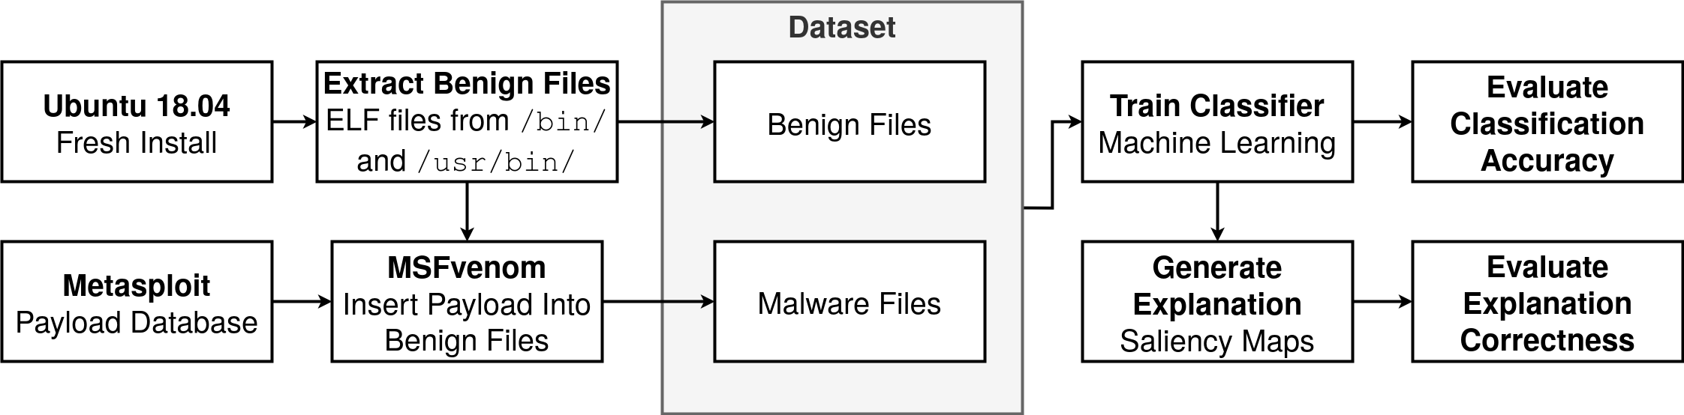
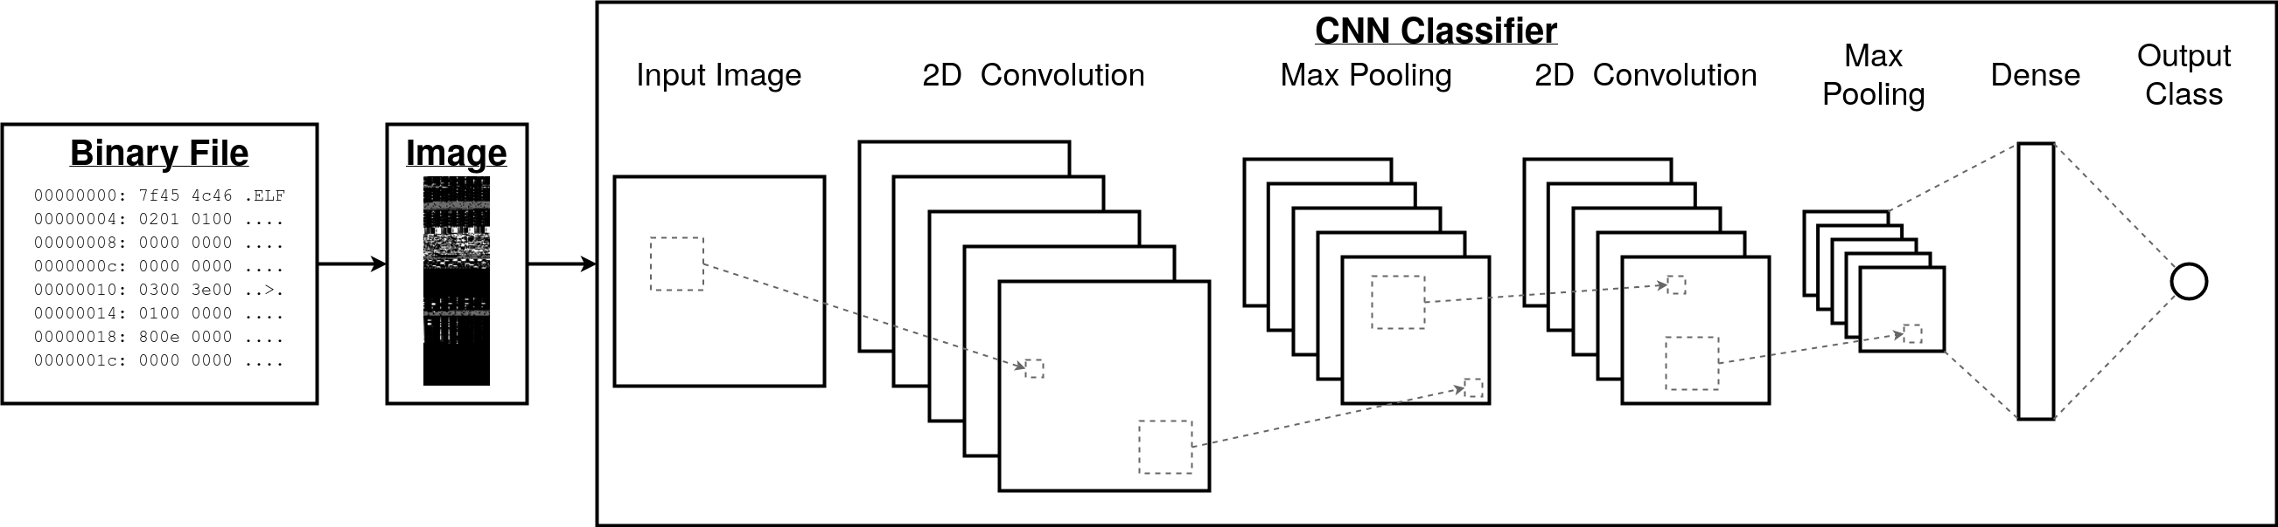


Acknowledgements
MiBeX: Malware-inserted Benign Datasets for
Explainable Machine Learning
Team 28
Thank you for funding from The Design Knowledge Company, Dayton, Ohio and Air Force Research Laboratory, Wright Patterson, Ohio ( Award # AFRL
Wayne Stegner
Computer Engineer
Process Overview
Dr. Rashmi Jha
Technical Advisor
FA8650-18-C-1191) for funding this research. Special thanks to Dr. David Kapp, Dr. Tem Kebede, and Daniel Koraneck for constructive technical discussion.
Challenges
Explainable AI
Saliency map code in [3] did not port to TensorFlow 2 as expected.
MSFvenom is difficult to debug and currently does not work as intended.
Explainable AI is important for system verification and improvement [1].
Neural networks are black box systems, meaning they have no native explanations for their decisions.
Saliency maps [2], representing an importance heat-map of each input node, are the gradient of the classification score with respect to the input:
Malware as Image Classification
Conclusion
We developed a highly scalable method to produce a dataset with fully intelligible malicious features.
$g_{c}=\frac{∂S_{c}\left(I\right)}{∂I}$
Future Work
Problem
Troubleshoot lack of functionality from malicious payloads.
Diversify dataset with multiple payloads from Metasploit or custom.
Pad files with benign assembly code instead of zeros.
Santacroce et al. [3] generated saliency maps for malware classification, but were unable to verify the correctness.
Need a malware dataset with known benign and malicious features.
Results
Dataset Generation
Generated 1103 files of each class, totaling 2206 files in the dataset.
Payload was inserted into the files, but no malicious activity was observed.
Example showing clear.benign (left) and clear.infected (right).
Malware as Image Classification
Achieved 100% training and 99.72% validation accuracy after 5000 epochs.
Network converged by 500 epochs and performance remained steady throughout training duration.
Not enough time to conduct saliency analysis.
References
Hypothesis
A custom malware dataset can be created to aid with validating the correctness of malicious features learned by machine learning algorithms.
[1] L. R. Biggers, C. Bocovich, R. Capshaw, B. P. Eddy, L. H. Etzkorn, and N. A. Kraft, “Explainable AI: understanding, visualizing and interpreting deep learning models,” Empir. Softw. Eng., vol. 19, no. 3, pp. 465–500, 2014, doi: 10.1007/s10664-012-9224-x.
[2] K. Simonyan, A. Vedaldi, and A. Zisserman, “Deep Inside Convolutional Networks: Visualising Image Classification Models and Saliency Maps,” pp. 1–8, 2013.
[3] M. Santacroce, W. Stegner, D. Koranek, and R. Jha, “A Foray Into Extracting Malicious Features from Executable Code with Neural Network Salience,” NAECON, 2019.
[4] “Metasploit.” [Online]. Available: https://www.metasploit.com/.
Solution
Malware Classification Results
Metric | Train Set | Test Set
True Positive | 719 | 177
True Negative | 716 | 181
False Positive | 0 | 0
False Negative | 0 | 1
Use MSFvenom tool from Metasploit [4] to insert malicious Trojans into benign files.
Harvest benign files from default Ubuntu installation.
Automate process with Makefile.
Malicious
Payload

